Slide 1
B.Sc-I
Chapter- Network Theorems.
Prof. Patil M.N.

Slide 2
Network Theorems

Slide 3
Objectives
At the end of this topic, you should be able to:
  apply the superposition theorem for circuit analysis
  apply Thevenin’s theorem to simplify the circuit for analysis
  apply Norton’s theorem to simplify the circuit for analysis
  understand maximum power transfer and perform circuit conversion

Slide 4
Superposition Theorem
The Superposition theorem states that if a linear system is driven by more than one independent power source, the total response is the sum of the individual responses. The following example will show the step of finding branches current using superpostion theorem

Slide 5
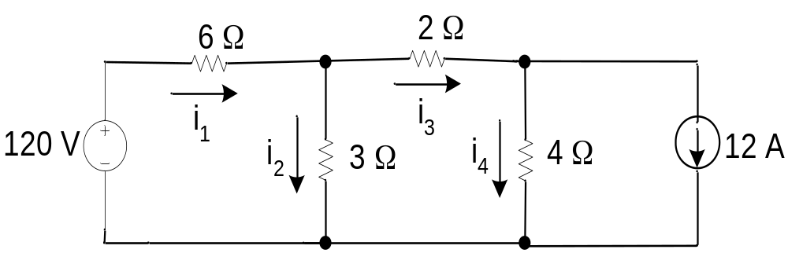
Refer to the Figure 1, determine the branches current using superposition theorem.
Figure 1
Solution
The application of the superposition theorem is shown in Figure 1, where it is used to calculate the branch current. We begin by calculating the branch current caused by the voltage source of 120 V. By substituting the ideal current with open circuit, we deactivate the current source, as shown in Figure 2.

Slide 6
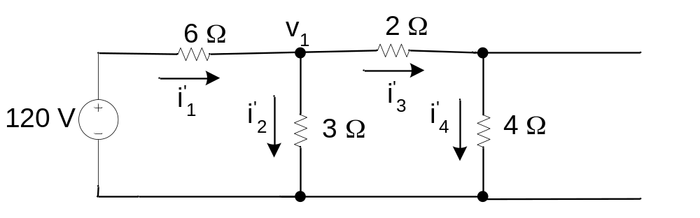
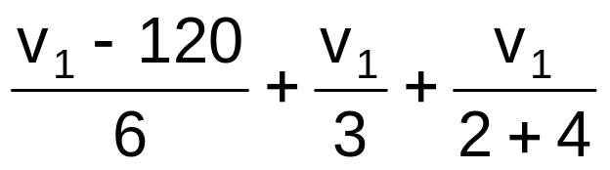
Figure 2
To calculate the branch current, the node voltage across the 3Ω resistor must be known. Therefore
= 0
where v₁ = 30 V
The equations for the current in each branch,

Slide 7
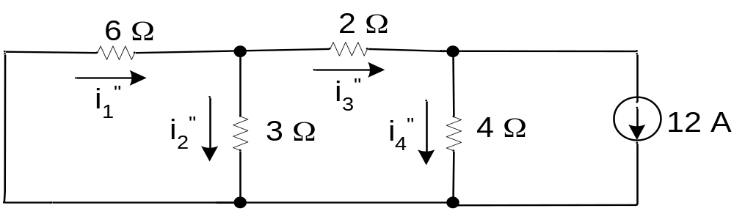
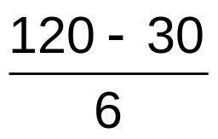


In order to calculate the current cause by the current source, we deactivate the ideal voltage source with a short circuit, as shown
i'₁ =
= 15 A
i'₂ =
= 10 A
i'₃ = i'₄ =
= 5 A

Slide 8
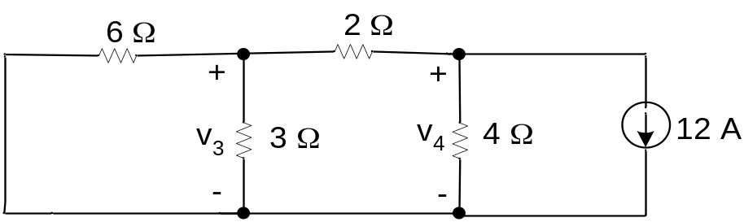
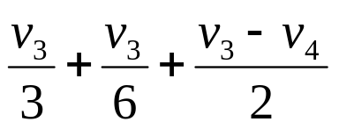
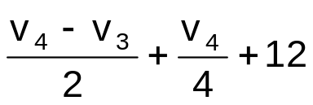
To determine the branch current, solve the node voltages across the 3Ω dan 4Ω resistors as shown in Figure 4
The two node voltages are
= 0
= 0

Slide 9
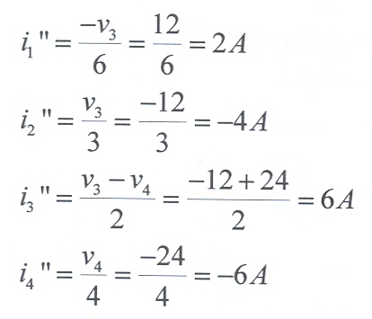
By solving these equations, we obtain
    v₃ = -12 V
    v₄ = -24 V
Now we can find the branches current,

Slide 10
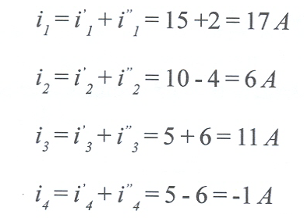
To find the actual current of the circuit, add the currents due to both the current and voltage source,

Slide 11
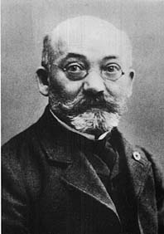
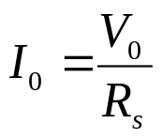
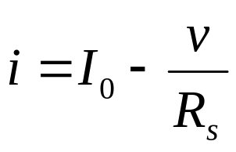
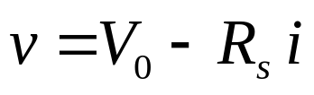
Thevenin and Norton Equivalent Circuits
M. Leon Thévenin (1857-1926), published
his famous theorem in 1883.
R_{s}
i
i
+
+
+
V₀
v
R_{s}
v
_
_
_
Fig.2.17 (a) Thevenin equivalent circuit ; (b) Norton equivalent circuit
The equivalence of these two circuits is a special case of the Thevenin and Norton Theorem

Slide 12
Thevenin & Norton Equivalent Circuits
Thevenin's Theorem states that it is possible to simplify any linear circuit, no matter how complex, to an equivalent circuit with just a single voltage source and series resistance connected to a load.
A series combination of Thevenin equivalent voltage source V₀ and Thevenin equivalent resistance R_{s}
Norton's Theorem states that it is possible to simplify any linear circuit, no matter how complex, to an equivalent circuit with just a single current source and parallel resistance connected to a load. Norton form:
  A parallel combination of Norton equivalent current source I₀ and Norton equivalent resistance R_{s}

Slide 13
Thévenin’s Theorem: A resistive circuit can be represented
by one voltage source and one resistor:
R_{Th}
V_{Th}
Resistive Circuit
Thévenin Equivalent Circuit

Slide 14
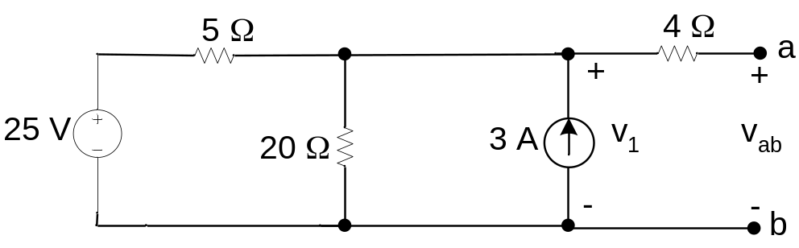
Example
Refer to the Figure 6, find the Thevenin equivalent circuit.
Solution
In order to find the Thevenin equivalent circuit for the circuit shown in Figure 6, calculate the open circuit voltage, vab. Note that when the a, b terminals are open, there is no current flow to 4Ω resistor. Therefore, the voltage vab is the same as the voltage across the 3A current source, labeled v₁.
To find the voltage v₁, solve the equations for the singular node voltage. By choosing the bottom right node as the reference node,

Slide 15
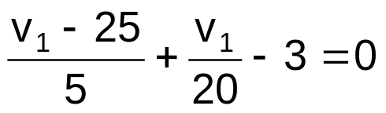
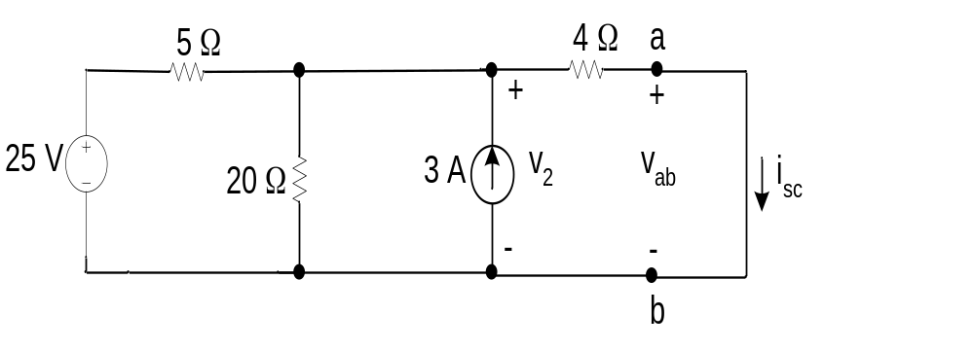
By solving the equation, v1 = 32 V. Therefore, the Thevenin voltage Vth for the circuit is 32 V.
The next step is to short circuit the terminals and find the short circuit current for the circuit shown in Figure 7. Note that the current is in the same direction as the falling voltage at the terminal.
Figure 7

Slide 16
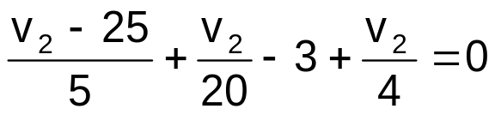


Current i_{sc} can be found if v₂ is known. By using the bottom
right node as the reference node, the equationfor v₂ becomes
By solving the above equation, v₂ = 16 V. Therefore, the short circuit
current i_{sc} is
The Thevenin resistance R_{Th} is
Figure 8 shows the Thevenin equivalent circuit for the Figure 6.

Slide 17
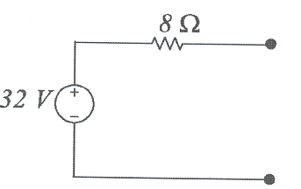
Figure 8

Slide 18
Norton’s Theorem
The Norton equivalent circuit contains an independent current source which is parallel to the Norton equivalent resistance. It can be derived from the Thevenin equivalent circuit by using source transformation. Therefore, the Norton current is equivalent to the short circuit current at the terminal being studied, and Norton resistance is equivalent to Thevenin resistance.

Slide 19
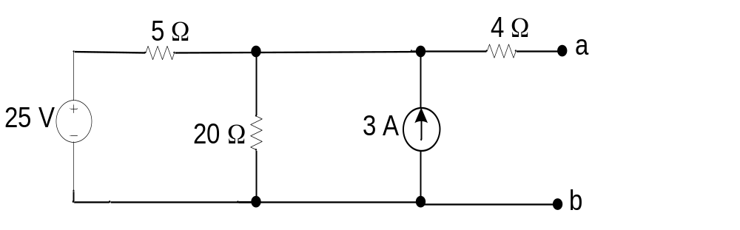
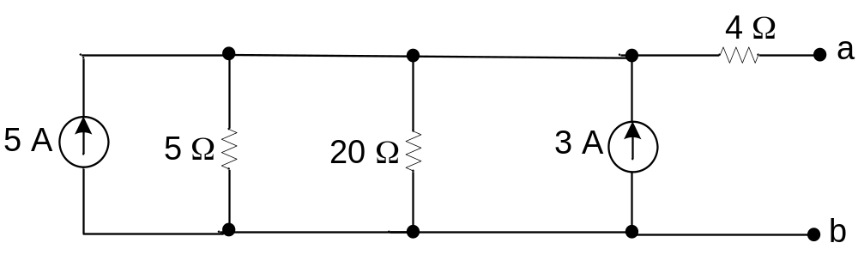
Example 3
Derive the Thevenin and Norton equivalent circuits of Figure 6.
Solution
Step 1: Source transformation (The 25V voltage source is converted to a 5 A current source.)

Slide 20
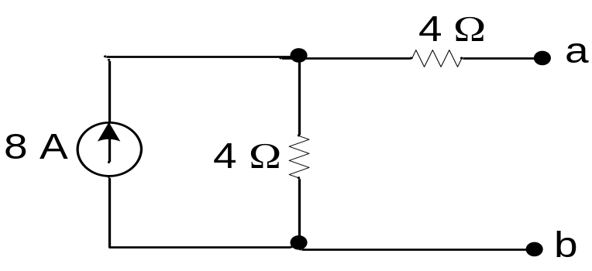
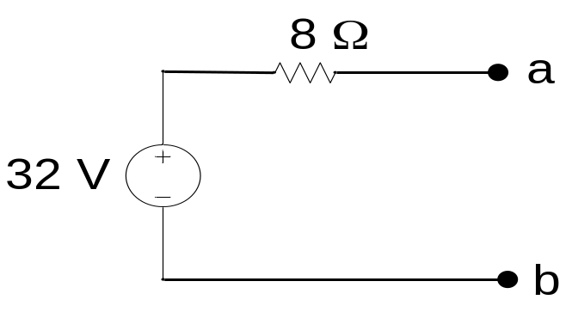
Step 2: Combination of parallel source and parallel resistance
Step 3: Source transformation (combined serial resistance to produce the Thevenin equivalent circuit.)

Slide 21
Step 4: Source transformation (To produce the Norton equivalent circuit. The current source is 4A (I = V/R = 32 V/8 Ω))
a
Ω
4 A
8
b
Figure 9 Steps in deriving Thevenin and Norton equivalent circuits.

Slide 22
Maximum Power Transfer
Maximum power transfer can be illustrated by Figure 10. Assume that a resistance network contains independent and dependent sources, and terminals a and b to which the resistance RL is connected. Then determine the value of RL that allows the delivery of maximum power to the load resistor.

Slide 23
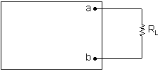
Resistance network which contains dependent and independent sources
Figure 10

Slide 24
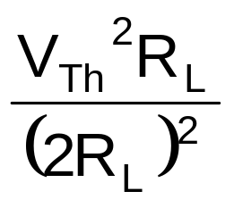
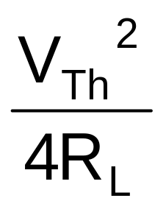
Maximum power transfer happens when the load resistance R_{L} is equal to the Thevenin equivalent resistance, R_{Th}. To find the maximum power delivered to R_{L},
p_{max} =
=

Slide 25
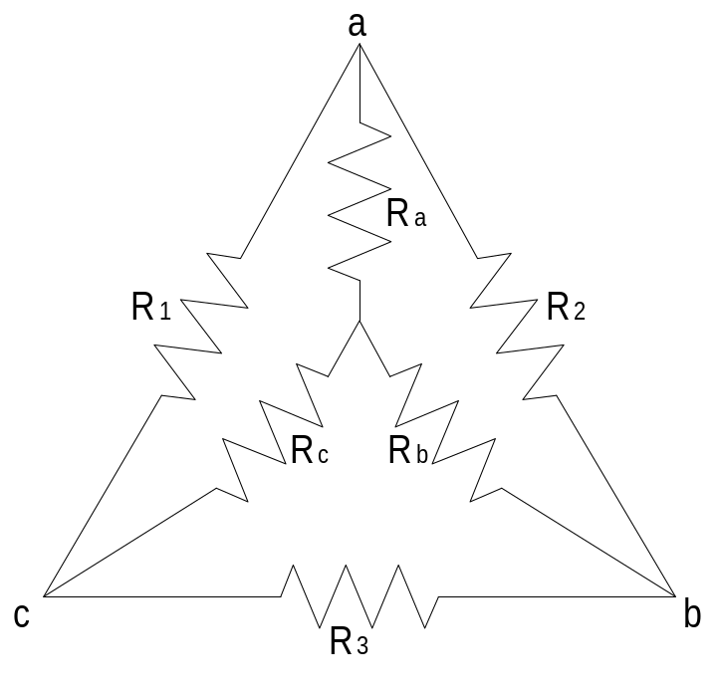
Circuit Transformation
The configuration of circuit connection can be changed to make the calculation easier. There are TWO type of transformations which are Delta (Δ) to star connection (Υ) and vice versa.
Figure 12 Delta and Star Circuit Connection

Slide 26
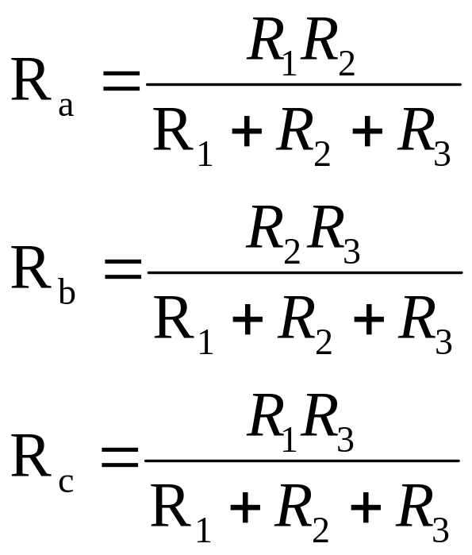
Delta (Δ) to star (Y) transformation:

Slide 27
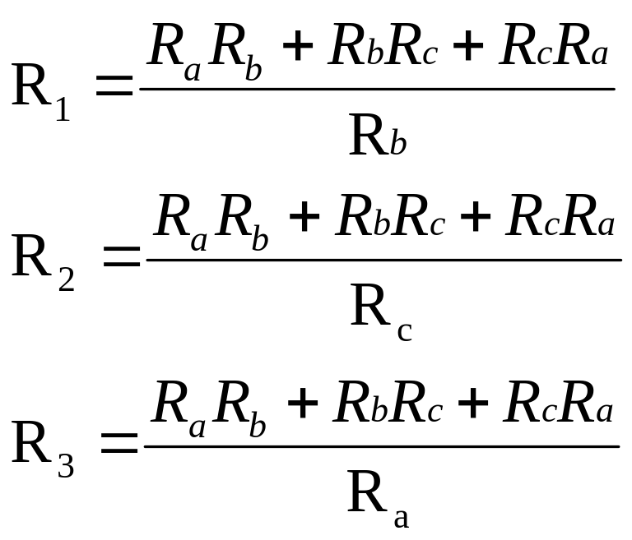
Star (Y) to Delta (Δ) transformation:

Slide 28
Thank You

